Slide 1
Team 516
Lunar Dust Glovebox
Mina Brahmbhatt, Nia Britton, Ryan Dreibelbis, Kendall Kovacs, Peter Mougey, Lawrence Terrell
November 19, 2024

Slide 2
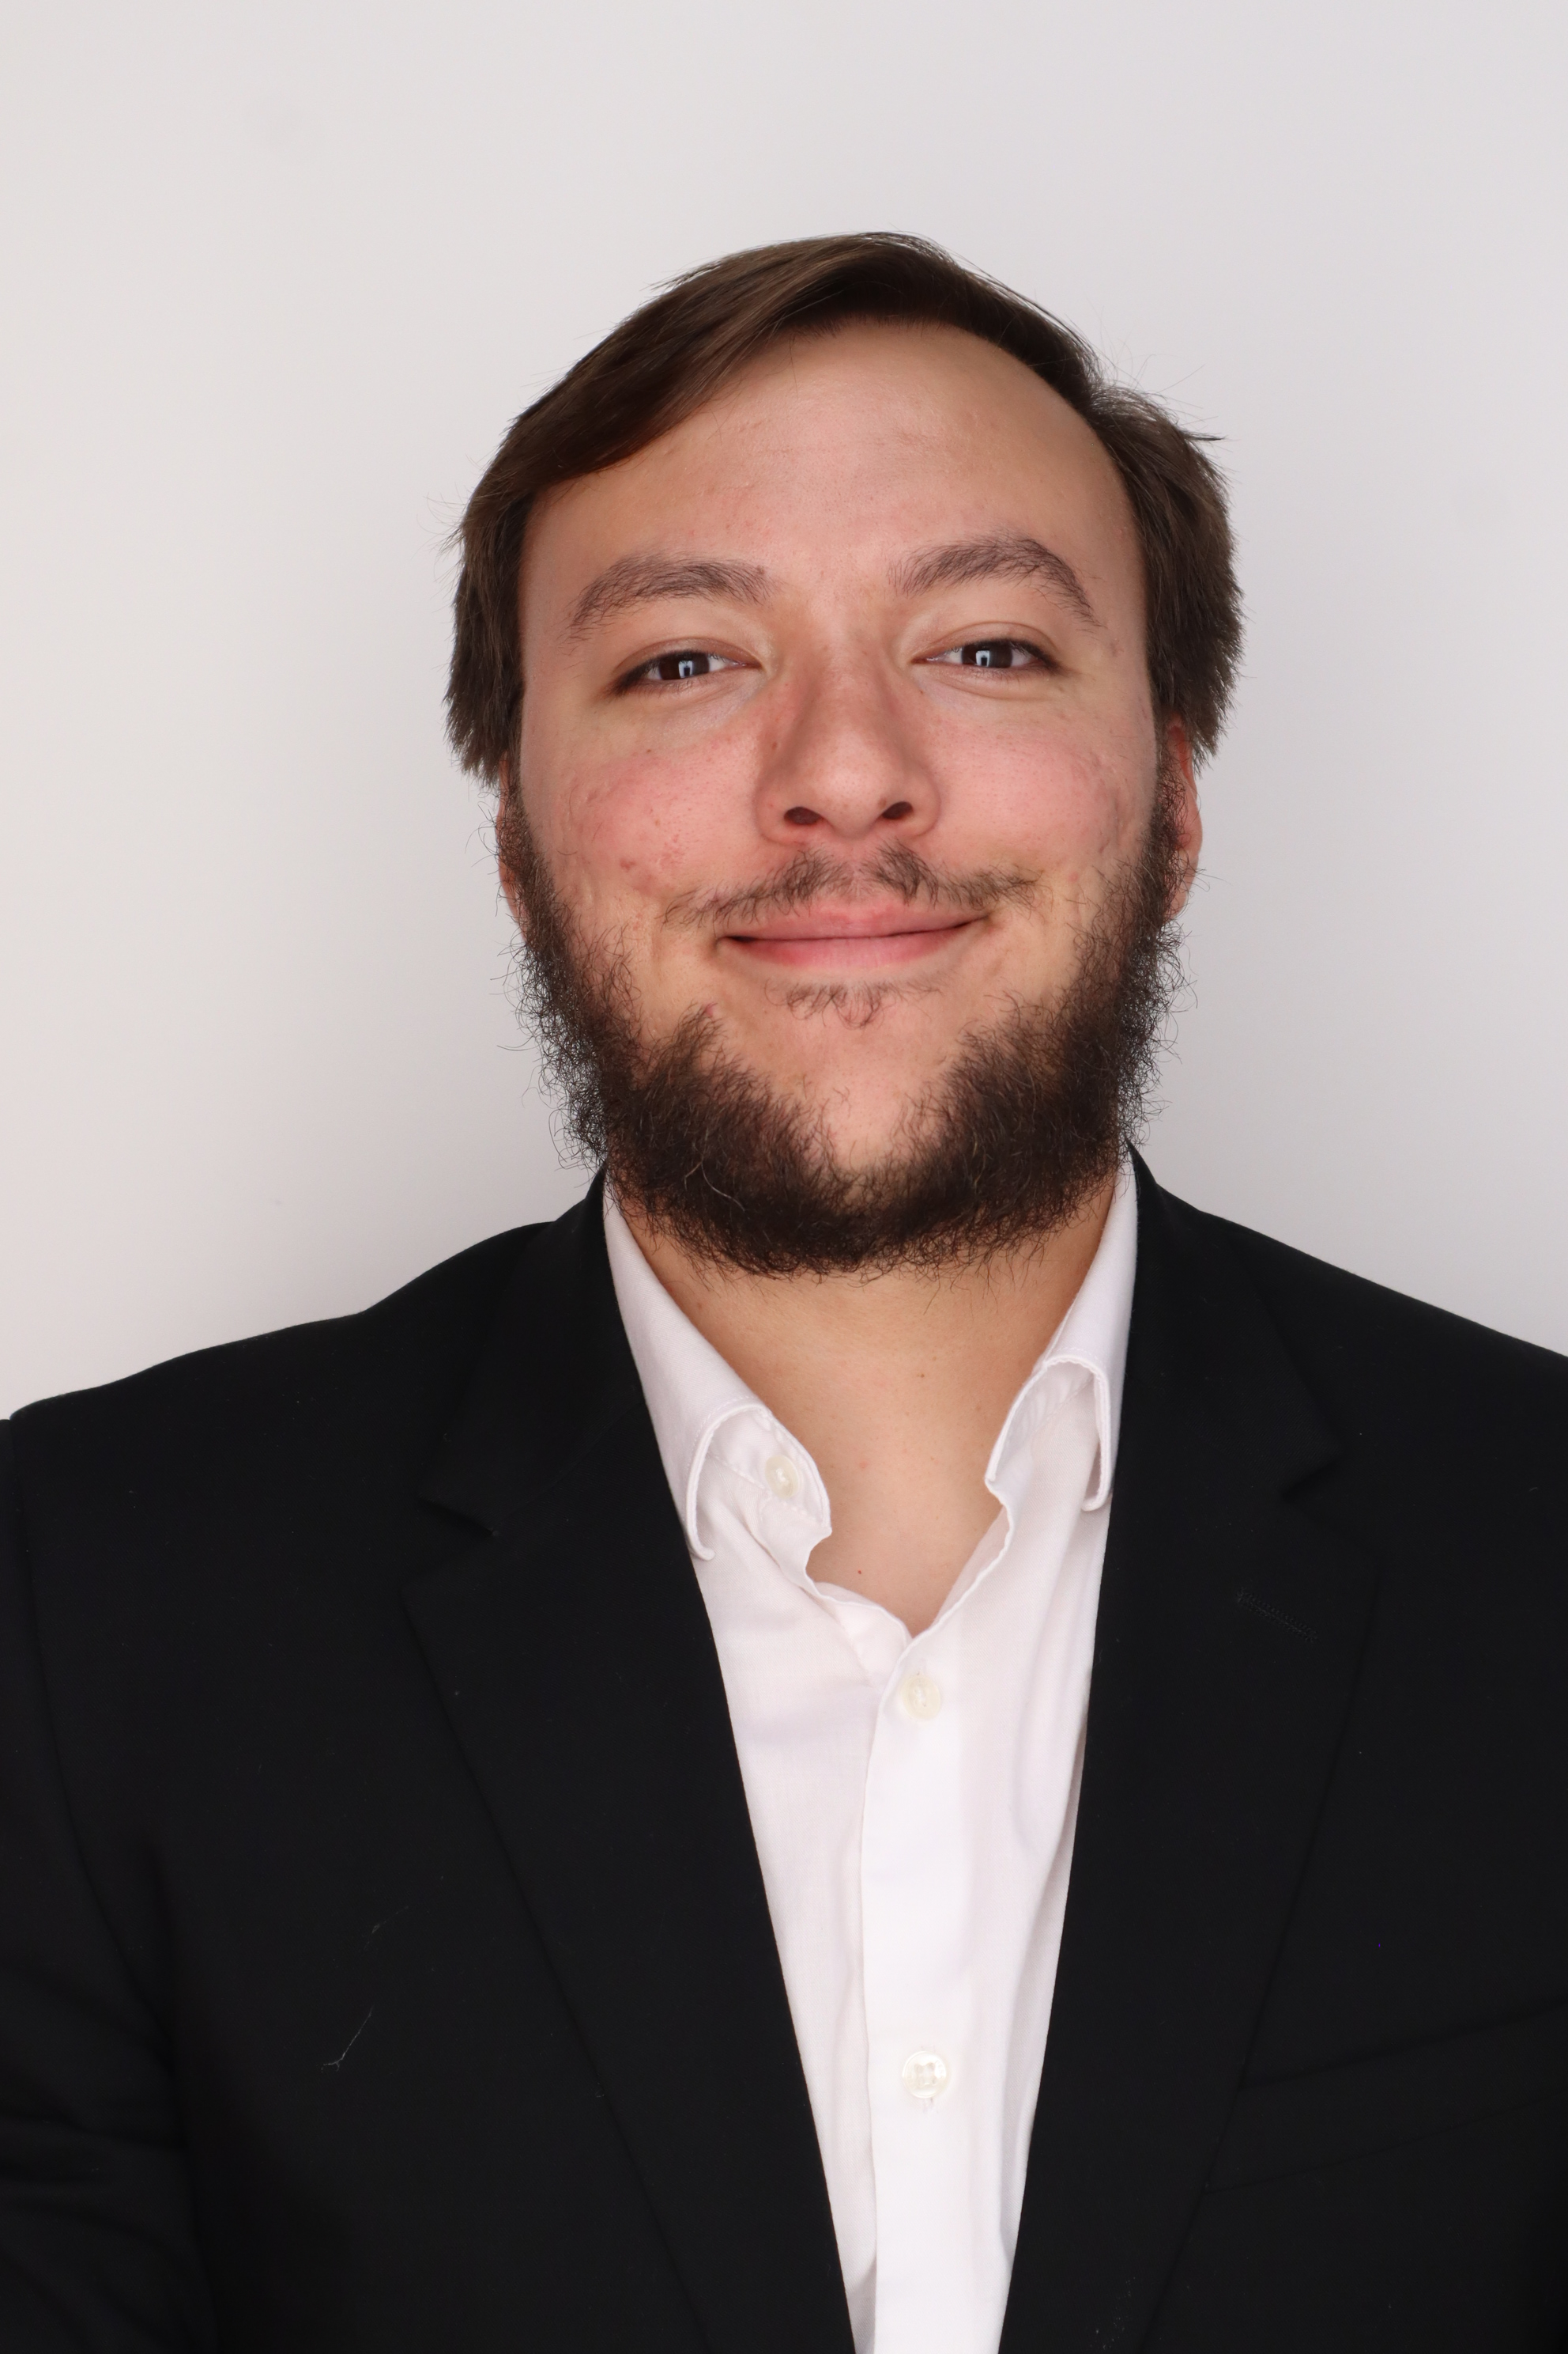
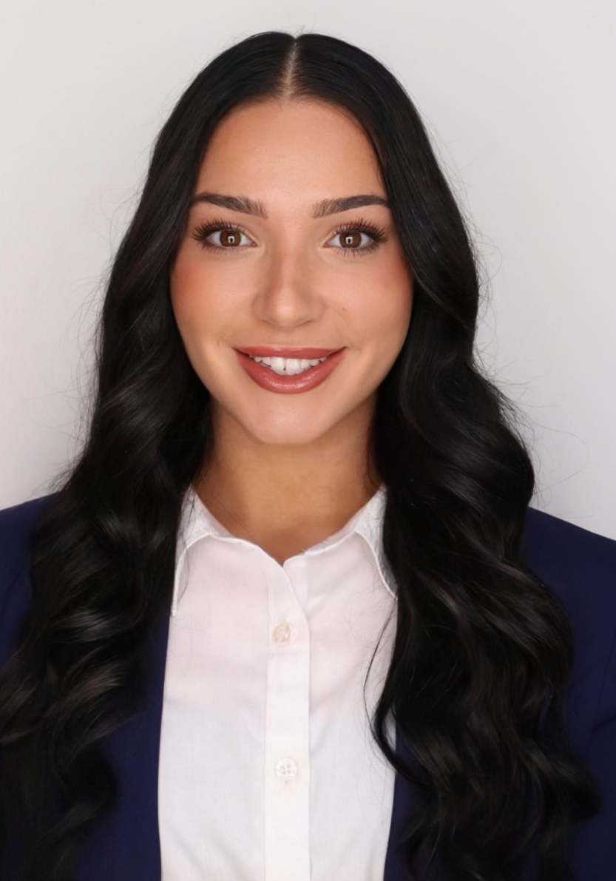
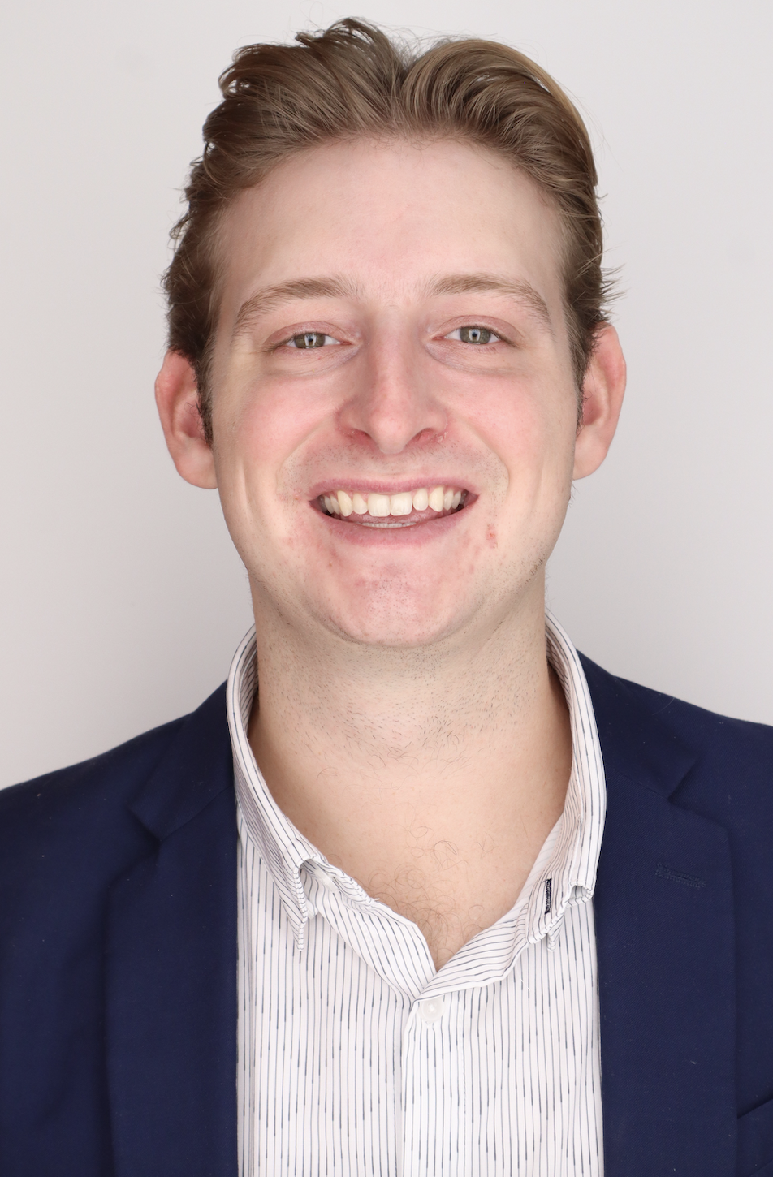
Our Team
Presenter
Nia Britton
Quality & Design Engineer
Kendall Kovacs
Project & Test Engineer, Point of Contact
Lawrence Terrell
Simulation & Fluids Engineer
Mina Brahmbhatt
Materials Scientist
Ryan Dreibelbis
Systems Engineer
Peter Mougey
Manufacture & Design Engineer
Presenter
2
Presenter

Slide 3
Sponsors
Peter Mougey
Amy Cassady
Orion Integrated Performance Lead
Amy Fritz
JSC Dust Mitigation Technical Lead
Brian Troutman
Human Landing System Crew Compartment Lunar Dust Mitigation Discipline Lead
Thomas Vassiliou
EX2 Spacecraft Performance and Concept Engineering (SPACE) Acting Deputy Branch Chief

Slide 4
Advisors
Peter Mougey
Dr. Brandon Krick Associate Professor
Dr. Shayne McConomy
Teaching Faculty II

Slide 5
Objective
Peter Mougey
The objective of this project is to optimize air flow to evenly distribute lunar dust simulant throughout a lunar dust glovebox.

Slide 6
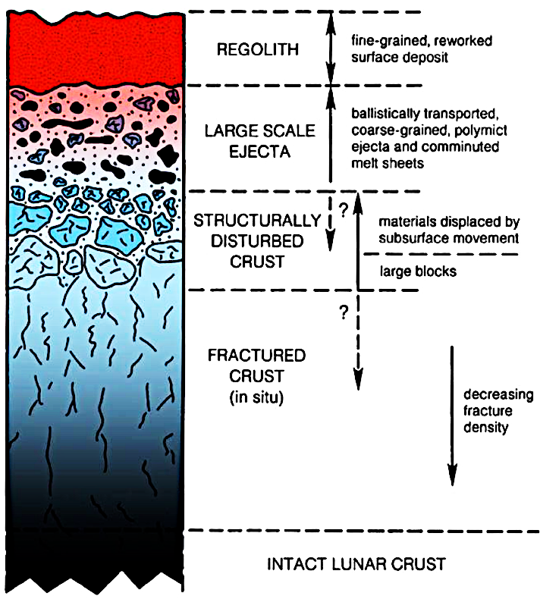
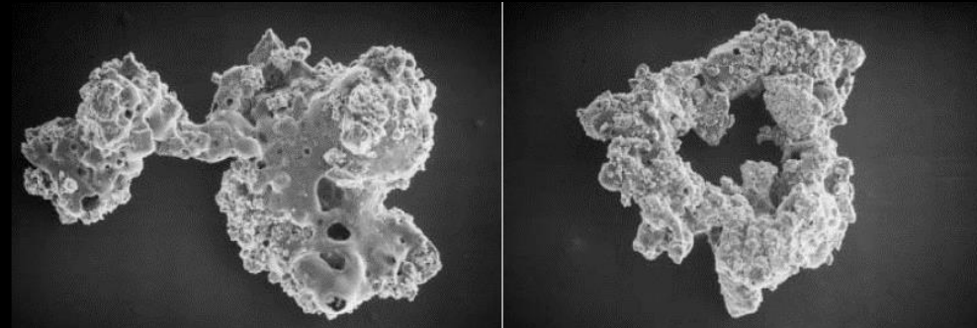
Project Background:
Lunar Regolith
Peter Mougey
Fragmental layer covering the lunar surface
Independent of rock size or composition
Notes:
-lunar regolith is the fragmental layer covering the lunar surface, independent of rock size or composition
-picture included is the cross section of the regolith structure and the microstructure; showing how its irregular boundaries make it sharp
a thick layer of unconsolidated rock, dust, and pebbles that covers the moon's surface.

Slide 7
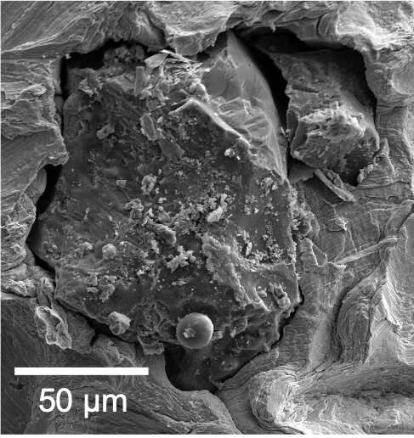
Project Background:
Lunar Dust
Peter Mougey
Fine particles of the lunar regolith
Average size is ~100 µm
Average density is 1.5 g/cm³

Slide 8
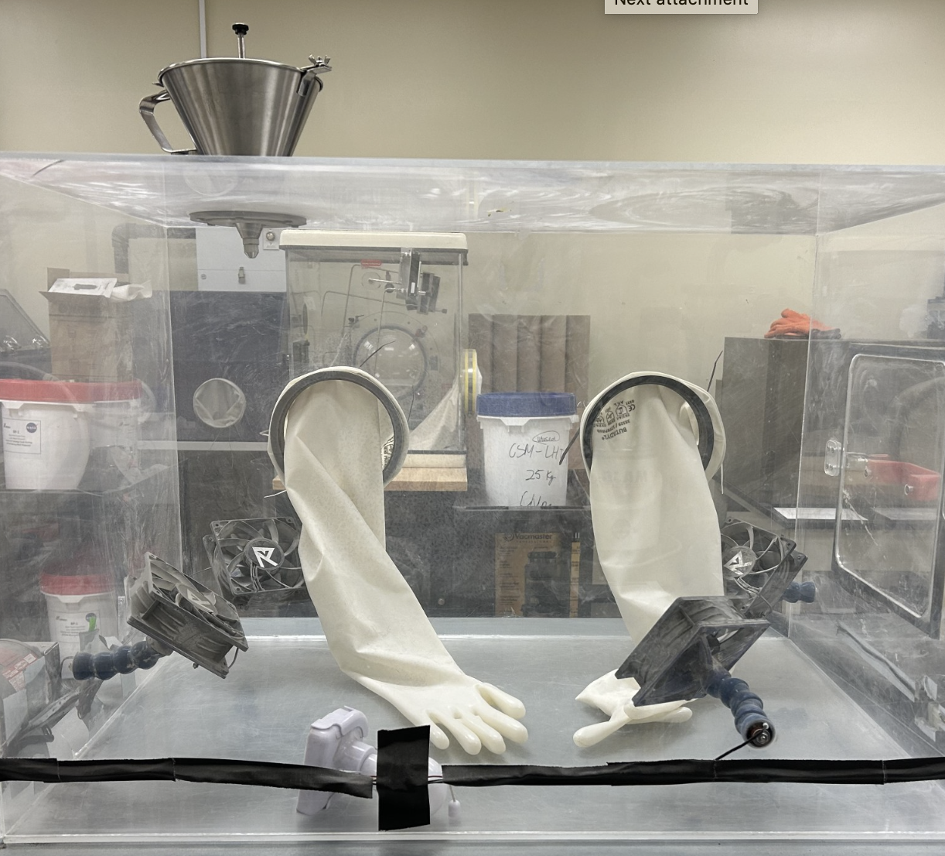
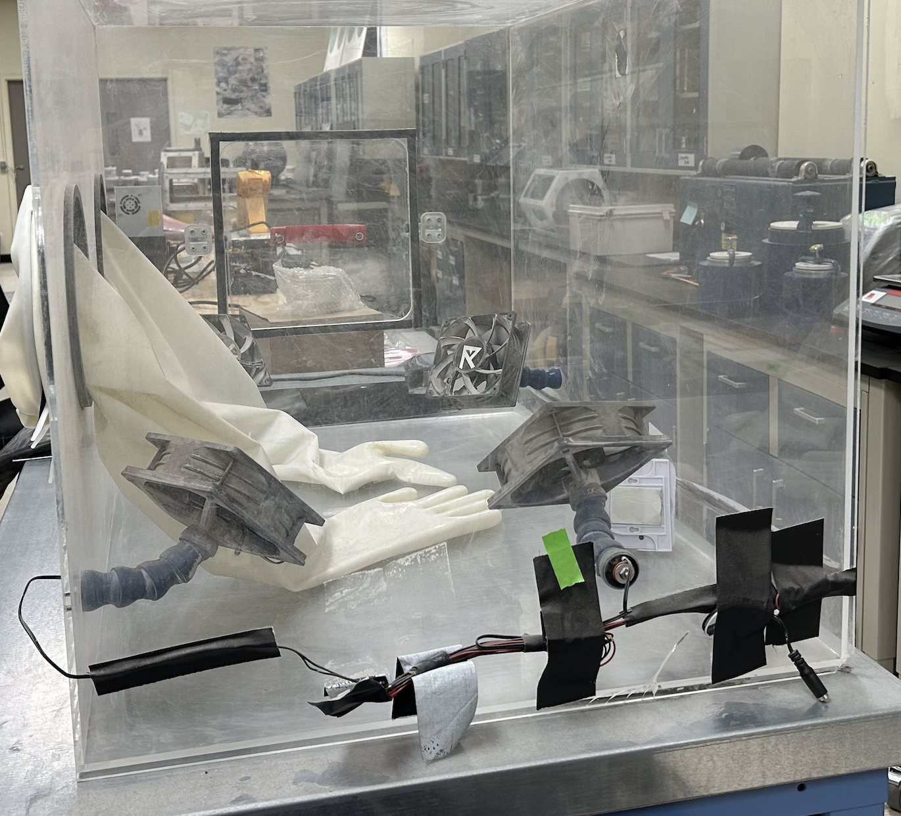
Project Background:
NASA-JSC & JSEG Glovebox
Peter Mougey

Slide 9
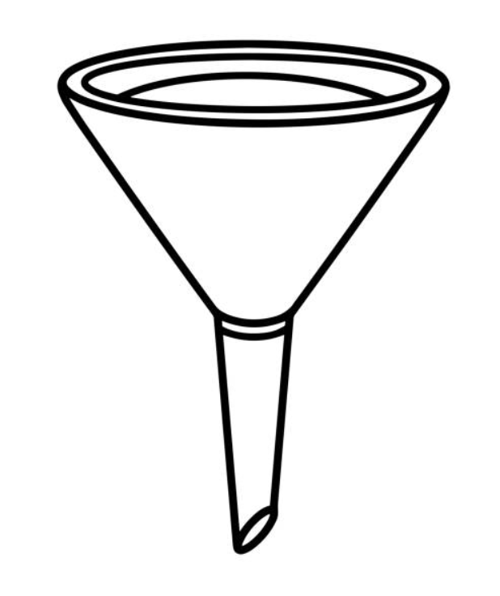
Project Background:
The Problem
Peter Mougey

Slide 10
Project Background:
The Problem
Peter Mougey

Slide 11
Project Background:
Overall Goals
Peter Mougey
Model air flow using CFD
Build and test glovebox design
Compare result with CFD

Slide 12
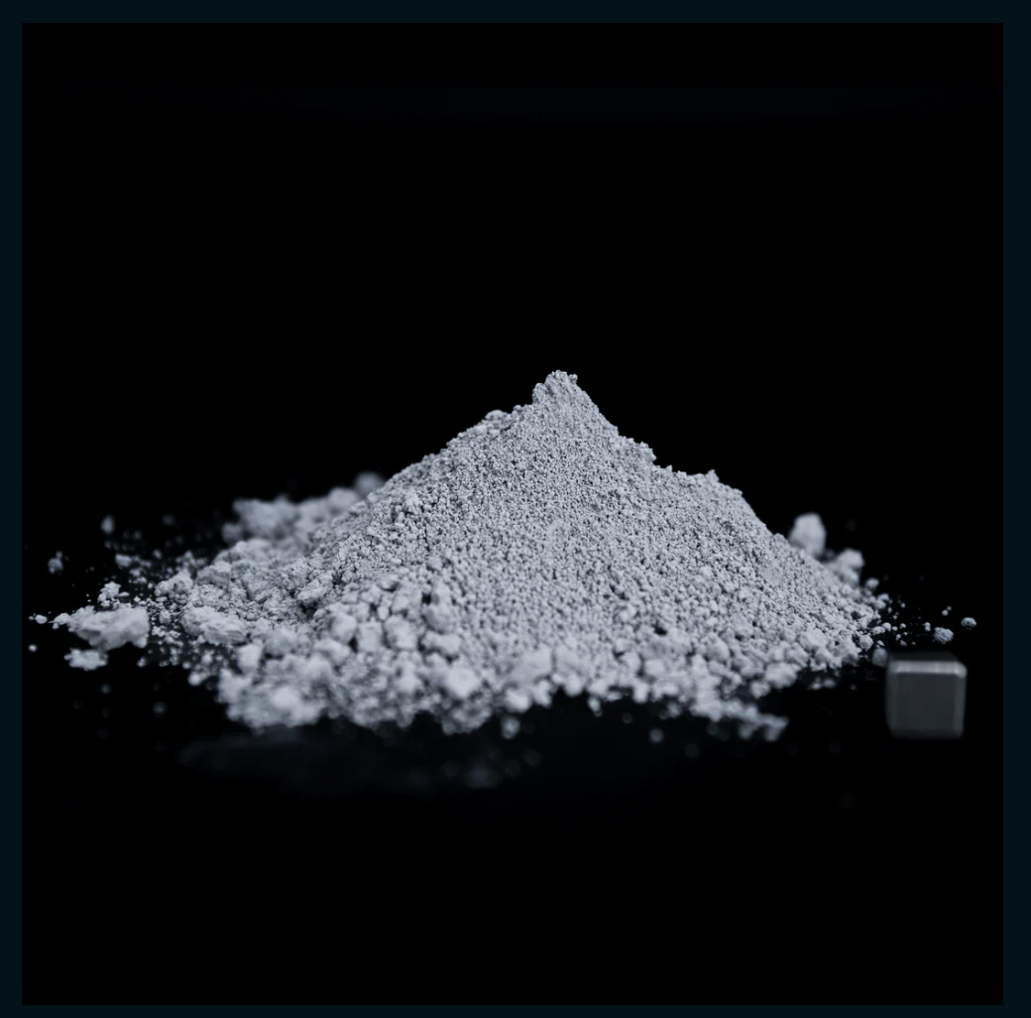
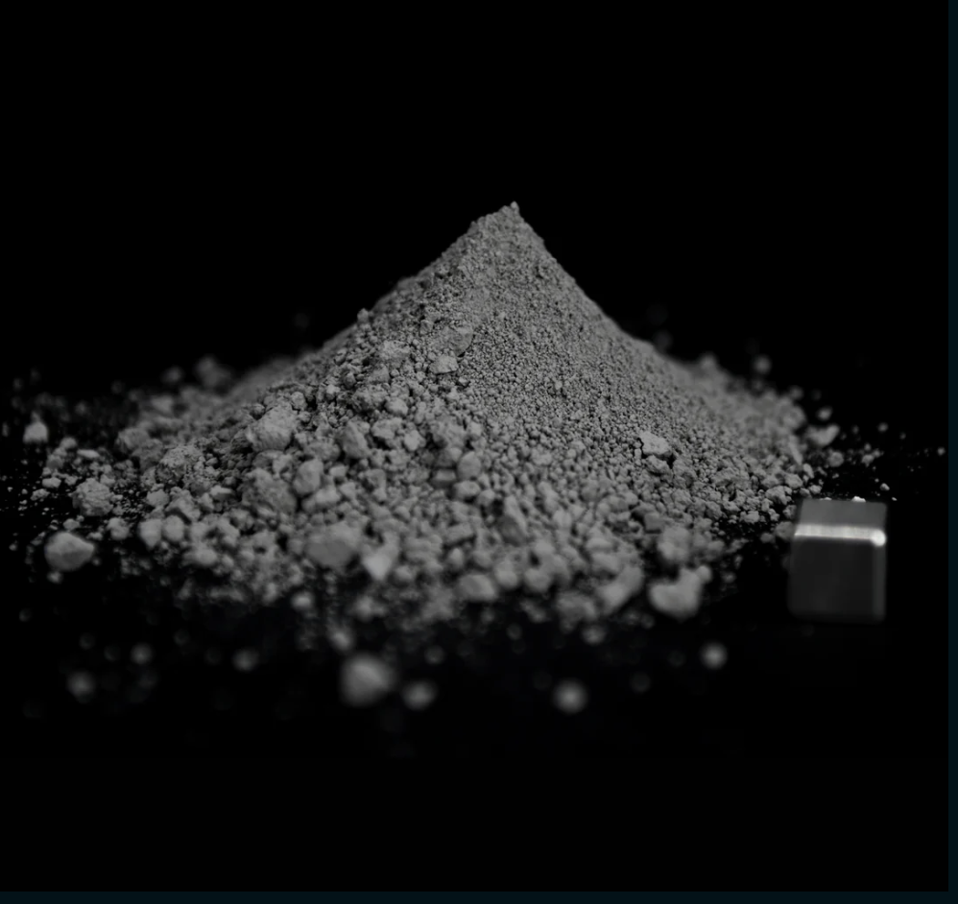
Selected Simulants:
Visual Differences
Peter Mougey
LHS-1D:
Lunar Highlands Dust Moon Simulant
LMS-1D:
Lunar Mare Dust Moon Simulant
Notes:
-Highlands is from the lighter part of the moon
-Mare is from the darker side of the moon
-Chose these because they fit the criteria for density needs (below 35 um) and they both come from the same company called Space Resource Technology
-IF ASKED: since we switched from LHS-1 to LHS-1D, the difference is a smaller particle diameter of 35 microns compared to 1 mm

Slide 13
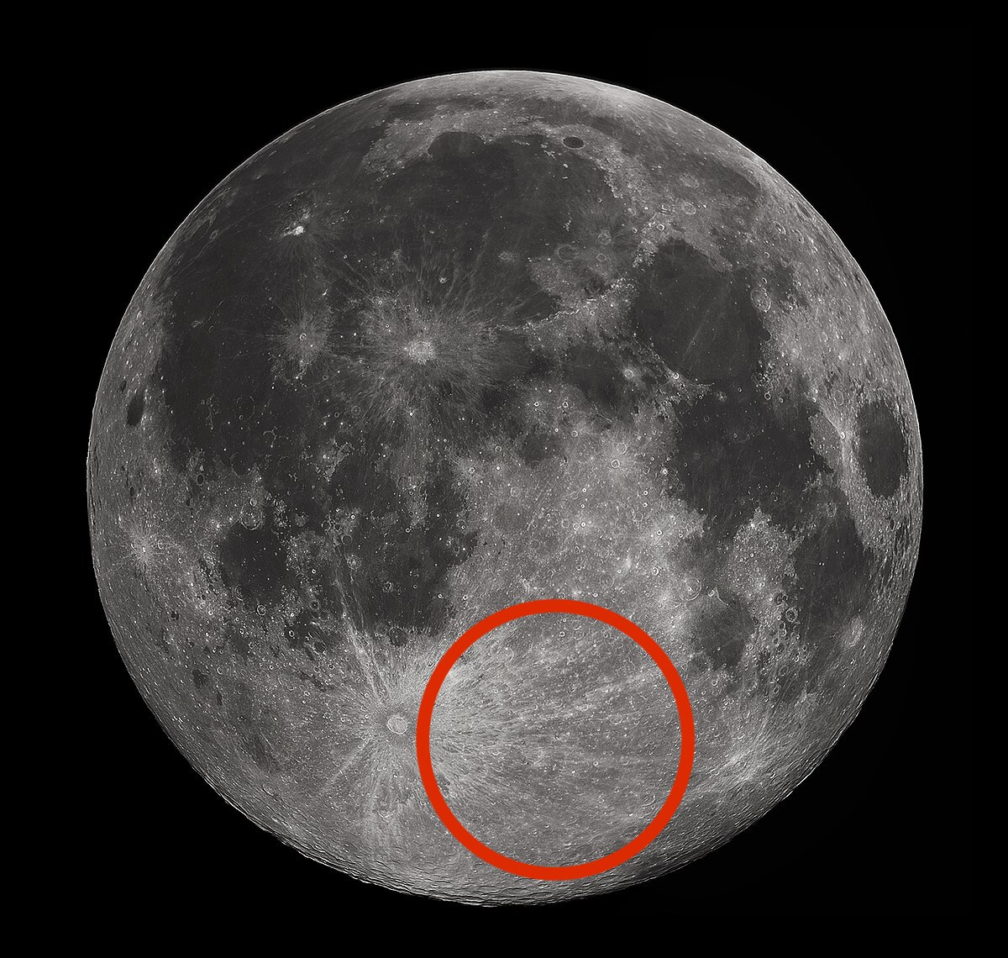
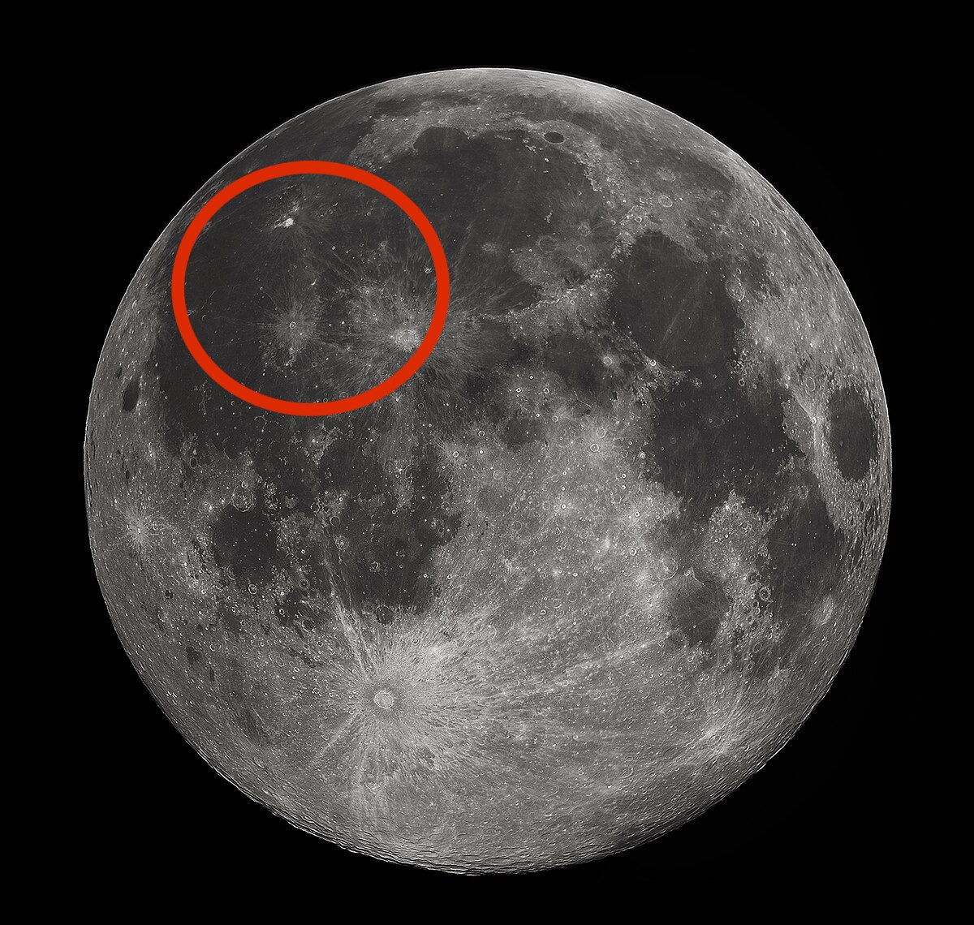
Selected Simulants:
Location Differences
Peter Mougey
LHS-1D:
Lunar Highlands Dust Moon Simulant
LMS-1D:
Lunar Mare Dust Moon Simulant
Notes:
-Highlands is from the lighter part of the moon: mainly anorthsite formed from slowly cooled lava
-Mare is from the darker side of the moon: mainly dark basalts formed from rapid cooled lava
-Chose these because they fit the criteria for density needs (below 35 um) and they both come from the same company called Space Resource Technology

Slide 14
Selected Simulants:
Properties and Shipping
Peter Mougey
LHS-1D:
Lunar Highlands Dust Moon Simulant
LMS-1D:
Lunar Mare Dust Moon Simulant
Order Size: 60g
Particle size range: <0.04 - 35 µm
Mean particle size: 7µm
Uncompressed bulk density: 0.79 g/cm^3
Approximated cost: $25
Approximated shipping: 2-3 weeks
Order Size: 60g
Particle size range: <0.04 - 35 µm
Mean particle size: 6 µm
Uncompressed bulk density: 0.79 g/cm^3
Approximated cost: $25
Approximated shipping: 2-3 weeks
Notes:
-Highlands is from the lighter part of the moon
-Mare is from the darker side of the moon
-Chose these because they fit the criteria for density needs (below 35 um) and they both come from the same company called Space Resource Technology
-Uncompressed bulk density is just the density that assumed zero outside pressure is acting on it

Slide 15
Anticipating Challenges: Targets and Metrics Generation
Peter Mougey
Problem:
Simulant particle too small to see with naked eye
Solution:
Fluorescent glass spheres
Problem:
Simulant sticking due to moisture
Solution:
Dehydrating simulant and spheres
Problem:
Visualizing the movement of particles and air flow
Solution:
Use Particle Image Velocimetry (PIV) to visualize particles
Notes:
Lunar Simulant is microscopically small there it is impossible to see with the naked human eye which makes monitoring the distribution of the simulant inside the glove box very difficult. To remedy this issue, fluorescent glass spheres with similar size and density will be placed in the glovebox with the lunar simulant as a method to visualize the position of the lunar simulant particles over time.
Explain these and how forseen challenges enabled us to locate certain metrics/things we need to accomplish

Slide 16
Visualizing content: UV Solution
Peter Mougey
Notes:
-explain that these are hard to see with the naked eye
-click next slide so they shrink

Slide 17
Visualizing content: UV Solution
Peter Mougey

Slide 18
Visualizing content: UV Solution
Peter Mougey
Notes:
Elaborate on Mina's solution for the camera and MATLAB stuff here

Slide 19
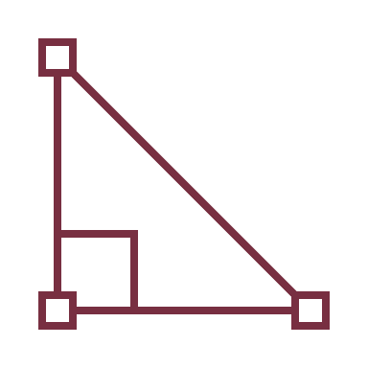
Targets and Metrics: CFD
Ryan Dreibelbis
Measures the Density of Air
Binary: Calculates Velocity
Binary: Optimized Angle of Air
1.225 kg/m³
Measurement based on standard
1
In m/s
Measurement based on pass or fail outcome from CFD run
1
Measurement based on pass or fail outcome from CFD run
Binary: Model of the Particle Flow
Binary: Calculates Particles Per Unit Area
Measures Earth Like Conditions
1
Measurement based on pass or fail outcome from CFD run
1
Measurement based on pass or fail outcome from CFD run
14.7 psi, 293.15 K, and 9.8 m/s²
Measurement based on standard pressure, temperature, and gravity of testing room
Notes:
Top 10 targets nad metrics brief
A velocity of at least 2.0 ± 1 m/s
50% of particles between 0-0.305 meters; 50% of particles between 0.305-0.61 meters
Density is within 15% of 1.5 g/cm3

Slide 20
Targets and Metrics: Tangible Glovebox
Ryan Dreibelbis
Measures Fan Velocity
Measures Particle Distribution
Binary: Optical Transmissivity
Velocity = 2.0 ± 1 m/s
Each fan assigned a velocity using PWM code
50% of particles between 0-0.305 m; 50% particle between 0.305-0.61 m
1
Measurement based on whether the elements in the glovebox can be seen
Binary: Non-Porous Material Used
Amount of Simulant in Glovebox
Measures Density of Simulant
1
The material will keep all elements within the enclosure contained
Density is within 15% of 1.5 g/cm³
Amount of simulant > 60g
Shows that a full test has occurred
Notes:
Top 10 targets nad metrics brief
A velocity of at least 2.0 ± 1 m/s
50% of particles between 0-0.305 meters; 50% of particles between 0.305-0.61 meters
Density is within 15% of 1.5 g/cm3

Slide 21
Concept Generation: Morphological Chart
Ryan Dreibelbis
Number of air flow sources and funnels
Computer fans vs. Air compressors
Glove box material and transparency
Sealant
Angles and positions of air flow sources and funnels

Slide 22
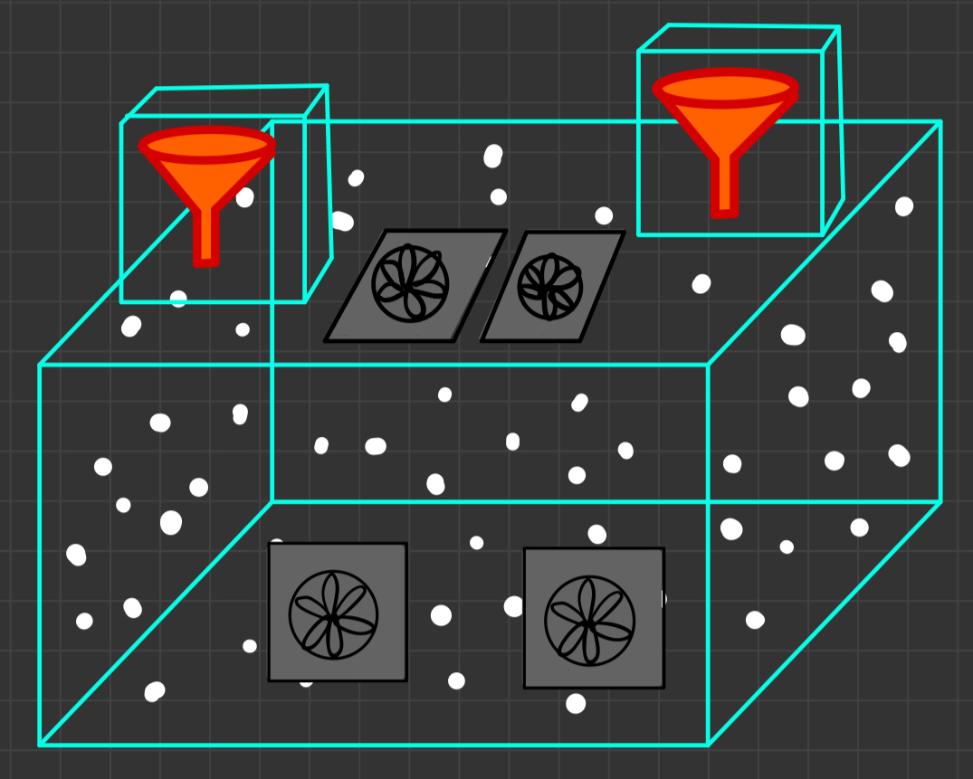
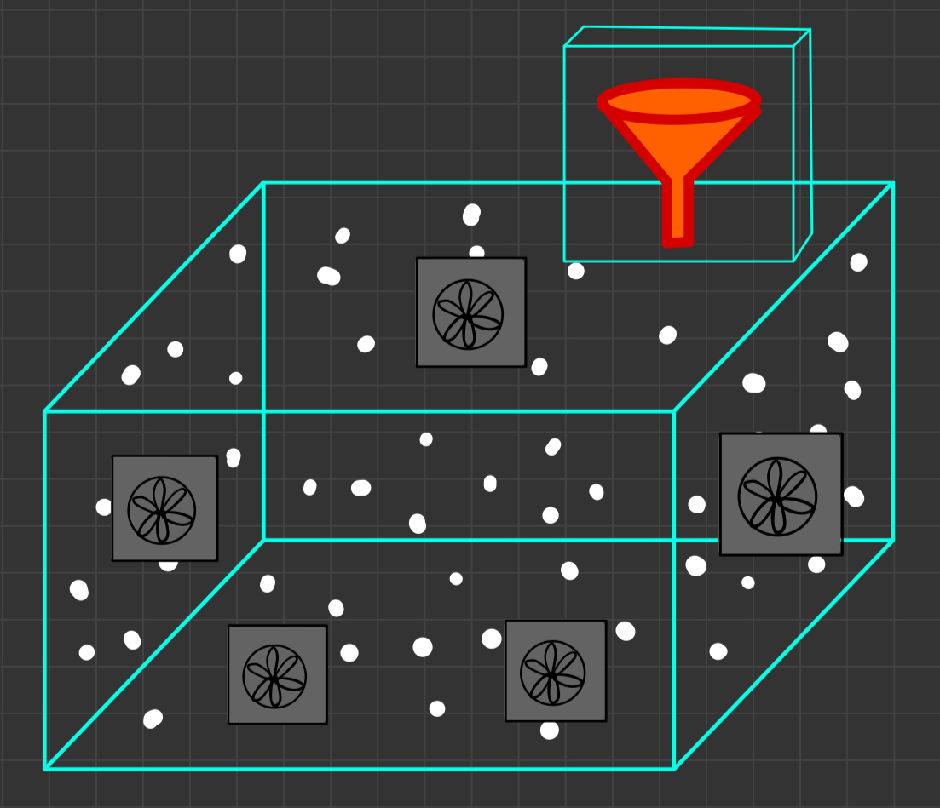
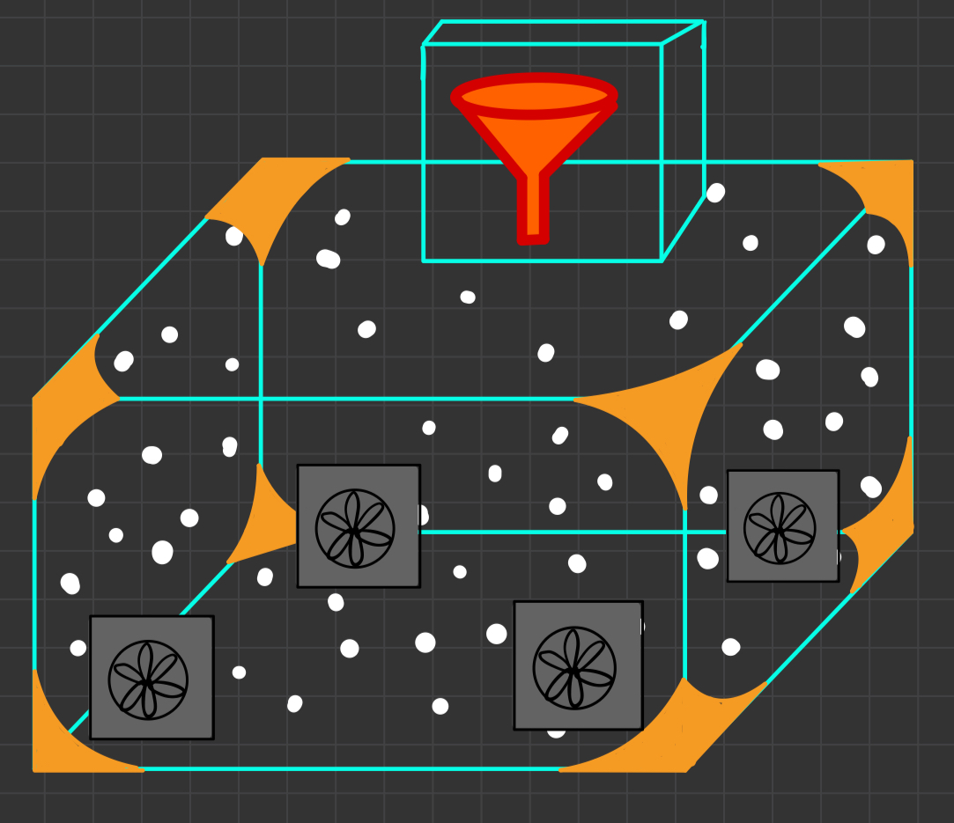
Concept Generation: High Fidelity Concepts
Ryan Dreibelbis
Morphological Concept One
Starfish Assembly
Curved Corner Concept

Slide 23
Concept Generation: Methods
Ryan Dreibelbis
Binary Pairwise Comparison Chart
House of Quality (HOQ) Chart
Pugh Charts
Analytical Hierarchy Process (AHP) Charts
Determines importance weight factor (IWF) for customer needs
Uses IWFs to turn customer needs into engineering characteristics and determine importance
Compares high and medium fidelity concepts to the market and to an average concept based on ability to perform engineering characteristics
Compares top three concepts by each engineering characteristic to get criteria weights, prioritize, and select the final design

Slide 24
Concept Generation: House of Quality
Ryan Dreibelbis
Seals Contents
2. Simulant Entrance Can be Resealed
3. Lofts Simulant
4. Funnel Mechanism Deposits Simulant
5. Allows Visibility
6. Maintains Steady Air flow
EXPLAIN CHARTS
7. Simulates Lunar Dust
8. Remains Stable
Notes:
-HOQ gave us which engineering characteristics were most important.
-maybe mention how we were satisfied with this outcome since 1st and 2nd place relates to keeping our team safe by not interacting with the simulant

Slide 25
Winning Concept: Alternative Design Comparisons
Ryan Dreibelbis
Air flow analysis over the physical structure analysis
No rounded corners
Only one simulant entry point
Fans vs compressor
Potentially dirty air
Avoid need for filter
CPU fan supremacy
Blows air directly and individual
GPU, PSU, and case fan issues
Ideal air circulation
0.45 meters from the glovebox walls
Notes:
(Why round glovbox wasn’t chosen
Why we used fans not compressor
Why we chose type of fans – CPU fans
Researched optimal distance from fan to wall)
the rounded off glovebox wasnt chosen because the sponsor want us to focus strictly on the flow of the air, not the physical build of the box, the phyusical build is an independent= variable.we moved forward with fans instead of compressors because compressors will introduce dirty air into the system and thats something else we have to worry about; using filters.cpu (central processing unit) fans are more individual and blow air onto the air directly, GPU fans come in pairs and triple, PSU and case fane suck in air rather than blow outoptimal distance from fans to glovebox wall, standard bedroom height is about 9 feet or 108 inches, and on average ceiling fans hang 8-10 inches from the ceiling to circulate air thru the room. using this same logic, if convert our glovebox's 2 ft height to 24 inches, we would need the fan to be about 1.78 in from the walls of the gloveboox for every position

Slide 26
Winning Concept: Design Breakdown
Lawrence Terrell
Balance
Strategic fan arrangement
Symmetrical like starfish
Fan setup
CPU fans
Offset from the walls
Funnel design
One funnel
Includes a sifter and O-ring
Plugged when not in use
Notes:
Stability produced due to arrangement of the fans
CPU fans will be used
Fans will be offset some distance from the walls
One funnel on the top of the glove box
Has a sifter and O-ring, and will be plugged

Slide 27
Winning Concept: CAD Model
Lawrence Terrell

Slide 28
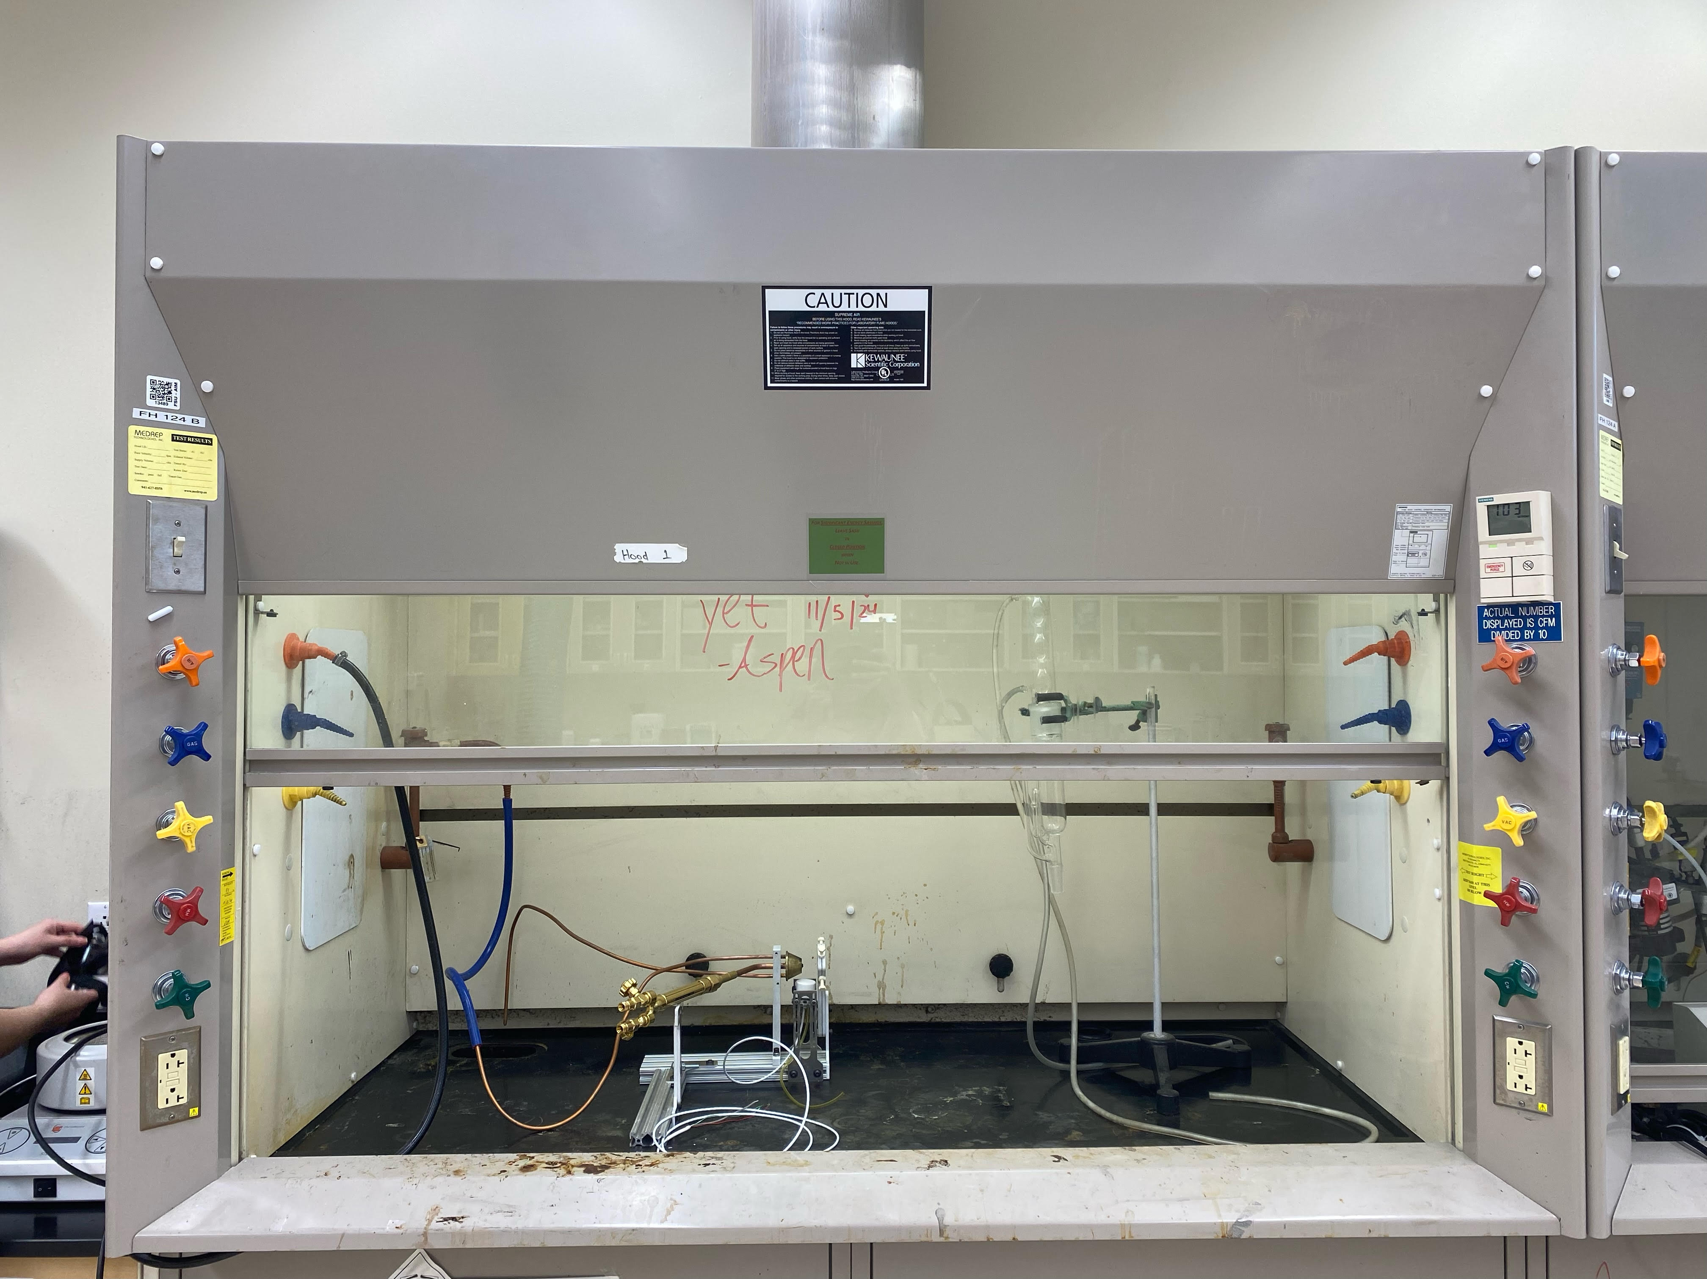
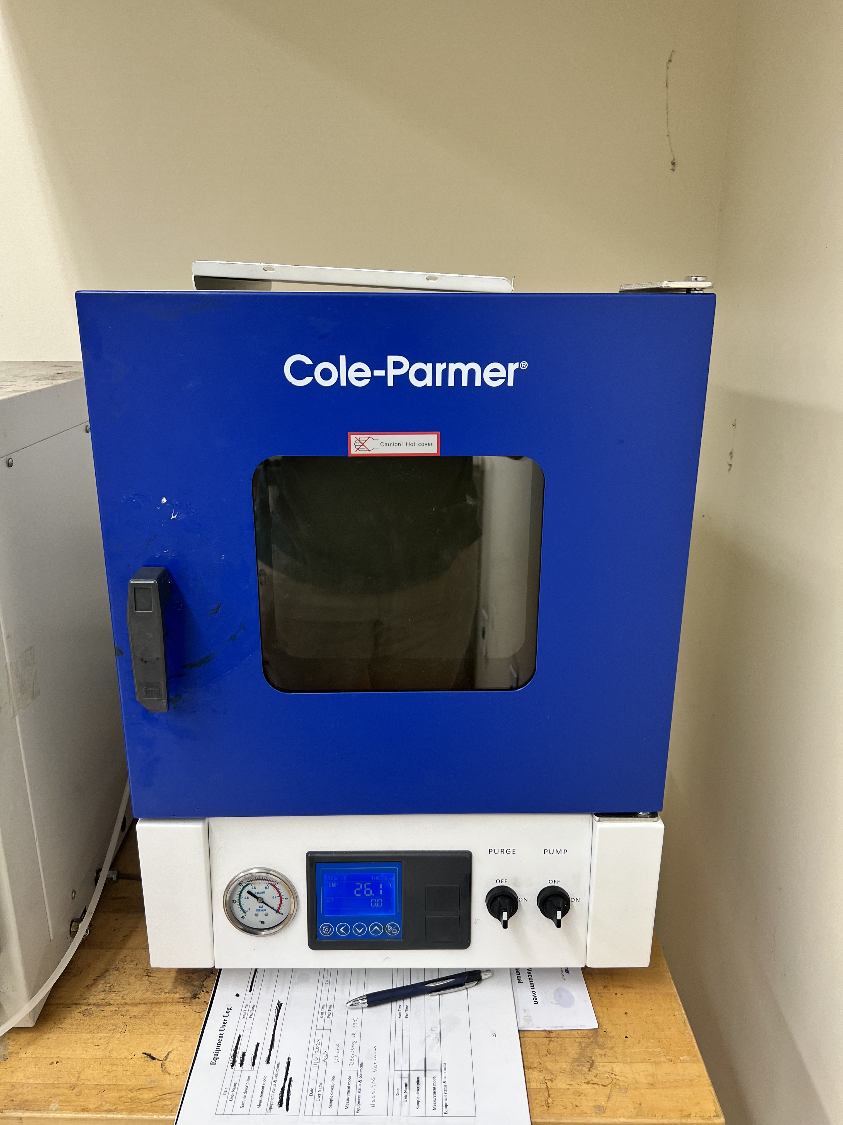
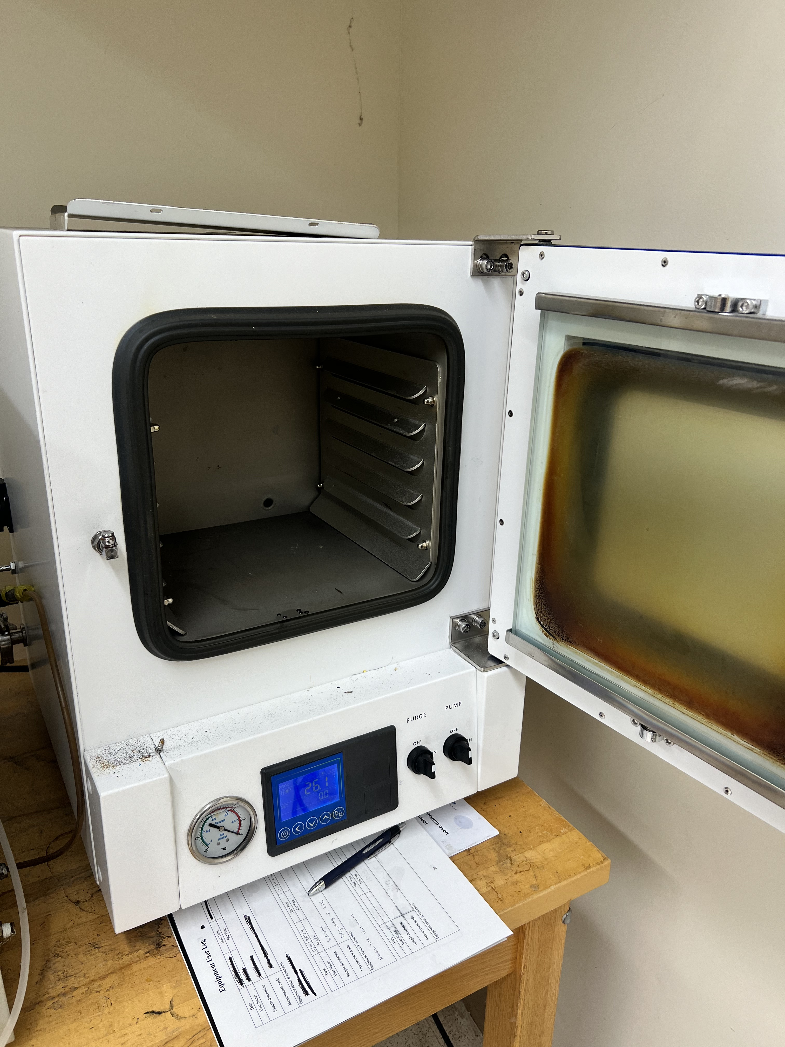
Experiment Details: Physical Set Up
Lawrence Terrell
Drying out the simulant
300°C ovens to dry out simulant
Glass petri dishes
Operating within the fume hood
Using room 124 in HPMI
UV lights
Direct reflection concerns
Preplaced fans
Potentially using two sets of fans
Fume hood in Room 124 at HPMI
300°C Ovens in Room 124
Notes:
HPMI Room 124
Glove box will be operated inside the fume hood
300°C ovens to dry out simulant
Glass petri dishes to place lunar simulant on inside the ovens
UV lights
Direct reflection concerns
Inside the fume hood
- Potentially use two sets of fans, with a fresh set for each new simulant batch.

Slide 29
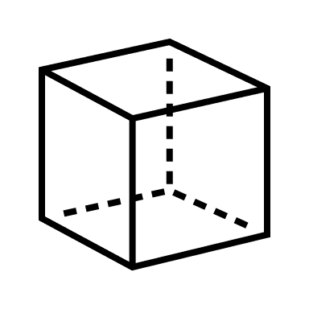
Experiment Details: Safety Equipment
Lawrence Terrell
PPE
Cleaning
Disposal
Disassembly

Slide 30
Experiment Details: Safety Plans
Lawrence Terrell
Safety protocols shouldn't rely solely on PPE
Fume hood
Goggles, N95 masks, and lab coats
Bake materials
Simulant and fluorescent glass microspheres
Reduce aerosolization risks
Disposal and cleaning
Wipe between runs
Wet materials for safer disposal
Notes:
Safety Independence from PPE Emphasize that our safety protocols shouldn't rely solely on PPE; N95 masks should be available, as they filter particles down to 30 microns.
Laboratory Setup and Equipment
- Utilize the larger fume hood in room 124; room 150 won’t be used.
- Include the fume hood in safety documentation and confirm its activity before experiments (using a paper towel test).
- Consider using UV lights on the front side of the box but address concerns about direct reflections.
Simulant and Experiment Procedures
- Bake the simulant and fluorescent balls before testing to reduce aerosolization risks.
- Clean the glovebox thoroughly between runs to manage hazards; disassemble and wet materials for safer disposal.
- Potentially use two sets of fans, with a fresh set for each new simulant batch.
PPE Adjustments Simplify PPE to safety goggles, N95 masks, and lab coats; eliminate hazmat suits and non-essential gap coverage. Focus on inhalation hazards, not full skin protection, and fit N95 masks properly.
Ventilation and Emergency Safety Confirm the fume hood is active instead of sealing the room. Check that safety showers and eye wash stations are operational before starting, and remove PPE before exiting the room.
Incident Protocols In case of a catastrophic event, highlight that the fume hood will contain hazards without needing additional sealing measures.

Slide 31
Ongoing Work
Lawrence Terrell
CFD Software Option Comparisons
Multiple simulation tools available (e.g., COMSOL, Abaqus)
Faculty Guidance
Dr. Nair and Dr. Shoele
CFD support
Modeling Approach
Continuum air flow
Notes:
Variety of software options for CFD simulation available, such as COMSOL or Abaqus Reached out to Dr. Nair and Dr. Shoele regarding CFD guidance from our advisor's advice The airflow in the glove box will be modeled as a continuum

Slide 32
Future Work
Lawrence Terrell
Set experiment dates and rent room 124
PDR
Completed CFD Simulations
Order Materials
Notes:
Just completed Preliminary Design REview with NASA to make sure we are on track and received great positive feedback, we are finishing up the budget report, starting our CFD simulations, and ordering materials
-mention that procurment log is done

Slide 33
Thank You! Floor is open for any questions or feedback!
Lawrence Terrell

